Slide 1
Highest Grossing Hollywood Movies Dashboard
File created on: 2022-02-12 2:30:07 PM EST

Slide 2
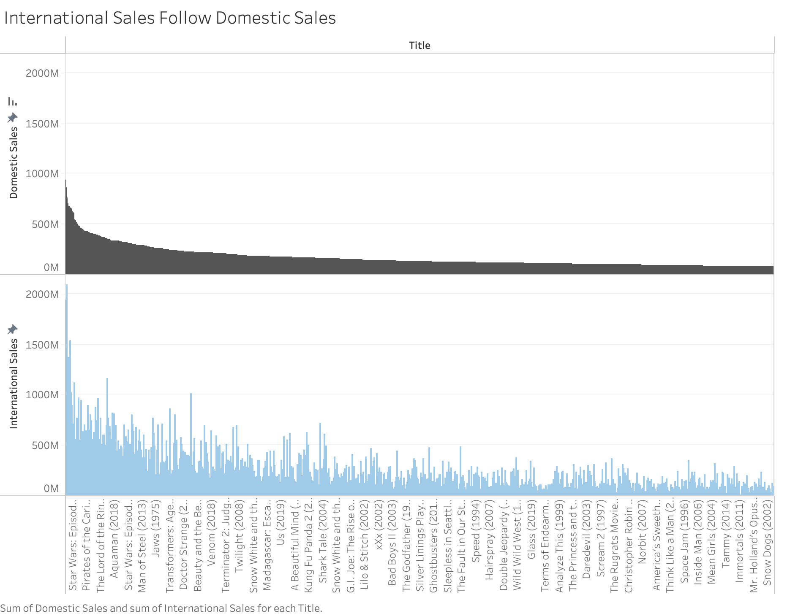

Slide 3
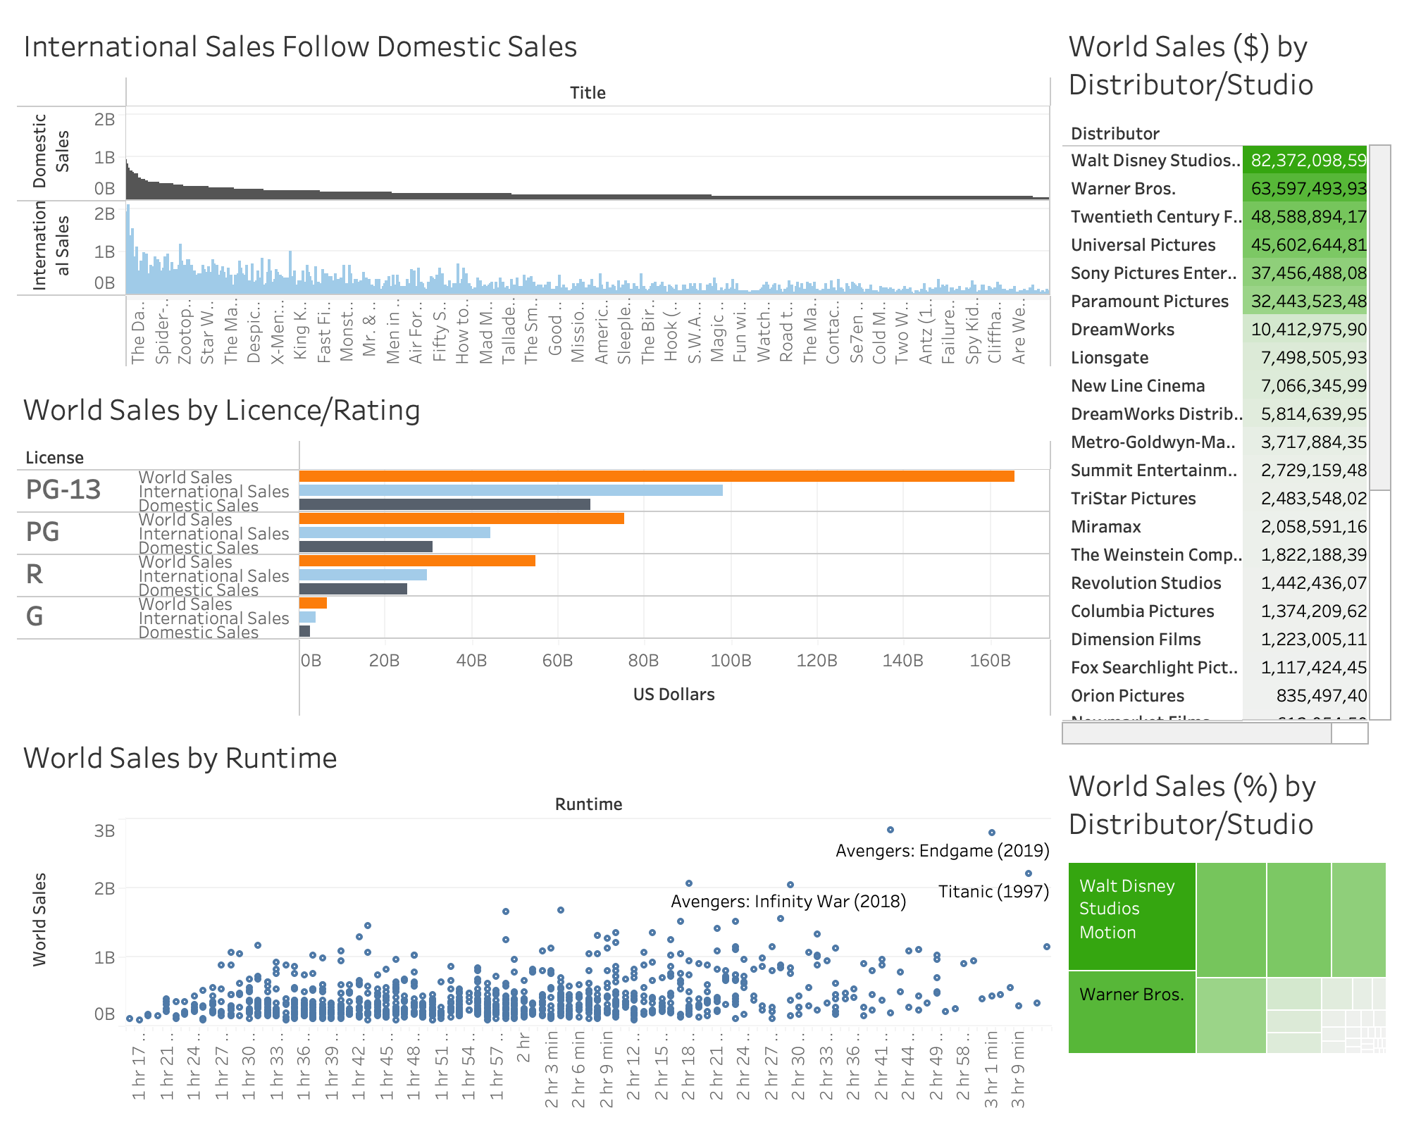

Slide 4
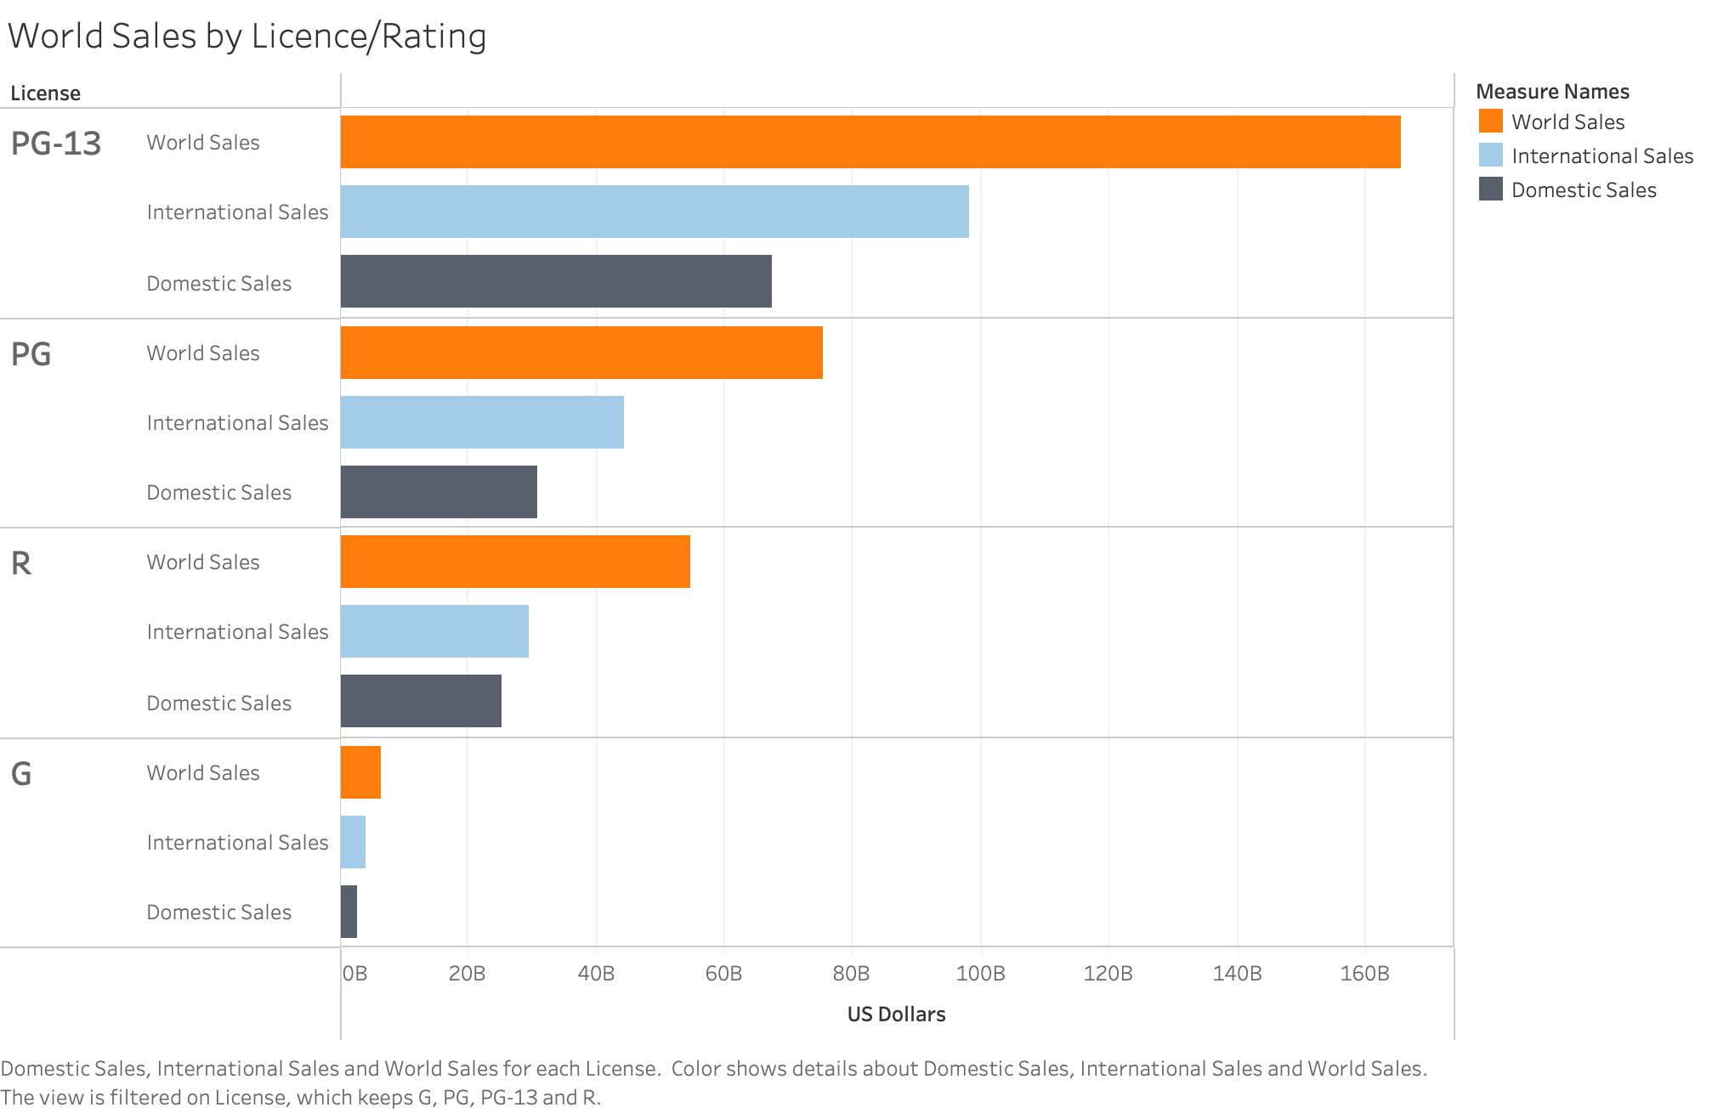

Slide 5
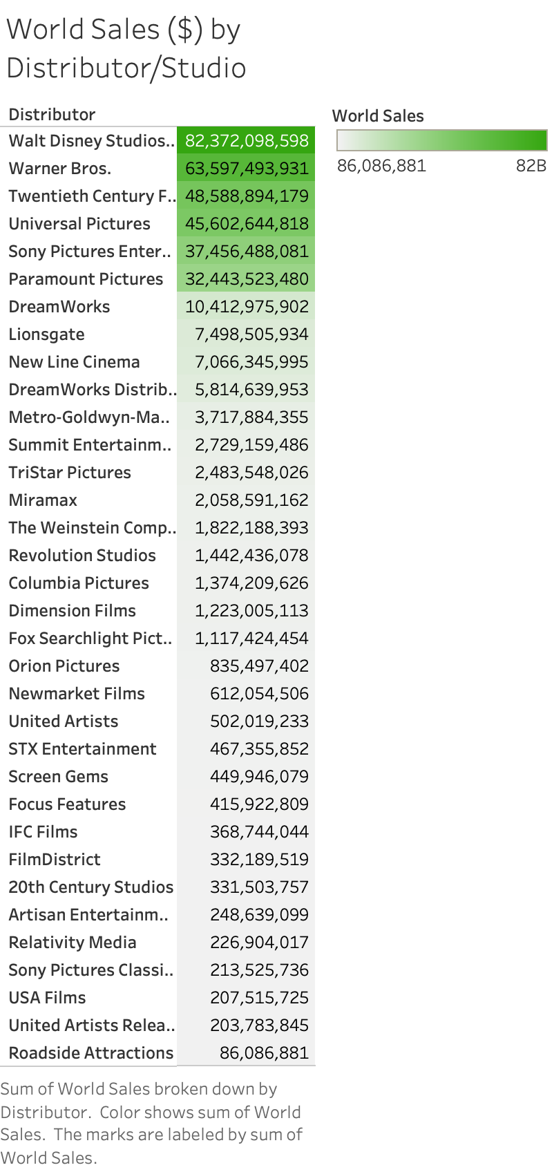

Slide 6
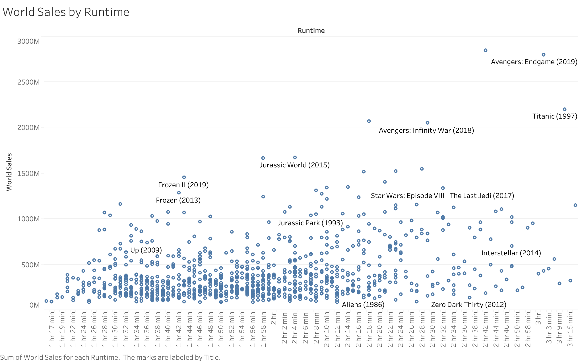

Slide 7
